Slide 1
COVID-19 in 2021: Navigating Return-to-Office Issues in the ‘Next Normal’
Presented by:
Dean L. Silverberg, Esq.
Epstein Becker Green, P.C.
June 10, 2021

Slide 2
Dean L. Silverberg
Member of the Firm
dsilverberg@ebglaw.com

Slide 3
COVID-19 in 2021: Navigating Return-to-Office Issues in the ‘Next Normal’—Introduction
Creating or Revising a Return-to-Office Plan: The Big Picture and a Deep Dive on Remote Work Issues
An Update on Paid Pandemic-Related Leave
The COVID-19 Legal Issue du Jour: Vaccination!

Slide 4
Introduction COVID-19 in 2021: Navigating Return-to-Office Issues in the ‘Next Normal’
2021’s New Perspective:
Business probably will not go back to the old normal
“Post-pandemic” era is not likely to be the same as old normal
Some changes seem here to stay, e.g.,
Greater focus on workplace health and safety
Greater acceptance of remote work – in some form
Not quite at the new normal phase
So much we don’t know yet, e.g.,
How long virus will remain a central concern
Will broadening of accommodation rules become permanent?
Is expansion of paid leave the future?
Greater focus on caregivers, getting women back in the workforce?
In the “next” normal – between old normal and new normal
Vaccines allowing gradual exit out of lockdown, but much remains unsettled, e.g., global containment, new strains, the post-pandemic economy

Slide 5
Creating or Revising a Return-to-Office Plan: The Big Picture and a Deep Dive on Remote Work Issues

Slide 6
Considerations Before Employees Arrive
Bringing back the workforce
Phased-in or “soft” reopening? Recommended!
Voluntary? If so:
Questionnaires?
Who does/does not want to return right away?
How will you handle high-risk employees who do/do not want to return?
Instruct employees who are successfully teleworking to continue to do so?
Consider part-time telework/part-time onsite? (Discussed later)
Stagger day/week schedules, e.g., Teams A, B, C work alternating days/weeks?
Vaccinations: Voluntary or mandatory? (Discussed later)
Training for all employees and managers
New health and safety protocols
New company policies/procedures
Changes to the office
To align with health and safety protocols and/or hybrid remote work plan

Slide 7
Considerations Before Employees Arrive (cont’d)
Create a Return-to-Office Management Team
Include: HR, IT, Legal, Security, Office Management, etc.
Identify who will oversee each aspect of the transition, e.g., who will:
Select employees – who returns first?
Design a safety program?
Oversee implementation?
Conduct employee training?
Evaluate/oversee structural/design changes to workspace?
Handle employee communications?
Address transportation issues?
ENSURE COMPLIANCE WITH ALL LEGAL OBLIGATIONS???
Develop “what if” protocols, e.g.,
Employee refuses to return to work
Employee refuses to leave office after exhibiting COVID-19 symptoms
Employee refuses to get vaccinated
Ensure coordination among team members

Slide 8
Remote Work: Here to Stay?
This year, 1 in 4 Americans will work remotely
By 2025, will rise to 1 in 3 or 36.2 million people – a staggering 87% increase in remote work from pre-pandemic levels
Recent survey:
90% of respondents will allow employees to work remotely at least part of the time, even after vaccination
65% reported that their organization will continue to offer employees flexibility on when they work
If remote work policy adopted, must ensure policy is
Nondiscriminatory under, and otherwise consistent with, all applicable laws
Uniformly applied
Remember, “home,” as in “WFH,“ can be anywhere, which may create a whole other set of legal headaches

Slide 9
Deep Dive Remote Working: Considerations
Initial assessment
Is it practical operationally?
Is it desirable and workable in building and maintaining company culture?
If “yes,” consider: only hybrid or mix of hybrid and F/T?
Survey employees?
Next consider – How will the firm:
Conduct employee mentoring and various kinds of training, including harassment prevention training?
Receive and investigate complaints of misconduct involving off-site workers?
Ensure managers and HR understand and comply with the company's legal obligations to provide eligible
employees — including remote workers — reasonable accommodations?
Protect confidential data and train, or retrain, remote workers on the company's security policies?
Recruit and acclimate new hires into the office culture?
Redesign the facility to better suit the needs of a hybrid workforce and to ensure a safe and healthy work environment, consistent with current law and guidance?
Address issues such as expense reimbursement and cybersecurity?
Avoid the “out-of-sight-out-of-mind” syndrome when assessing employee performance?

Slide 10
Remote Working: Four Key Issues
Creating or Updating a Remote Work Policy
Protecting Confidentiality and Employee Privacy Interests
Avoiding Discrimination & Accommodation Pitfalls
Expense Reimbursement

Slide 11
Creating/Updating a Remote Work Policy
Considerations
Is there an existing policy?
If so, is remote work an employee benefit, permitted as a privilege, able to be taken away if performance declines? If so, assess:
Is this still the case?
Or are we requiring our employees to work remotely?
If so, focus will need to change
If no current remote work policy, but remote work will continue at least during “next normal” phase, a policy is recommended
Remote work policies should include:
safety/health protocols
wage/hour and timekeeping rules
confidentiality/privacy concerns/protections
expense reimbursement practices
anti-discrimination, anti-harassment, and accommodation policies and complaint process
ability to require in-office work if performance suffers or operational needs change

Slide 12
Protecting Confidential Information
Ensure company policies on confidentiality and data security address WFH issues, e.g.,
WFH employees may NOT
transfer company documents to personal accounts/computer
use public-access servers (that includes Starbucks’ Wi-Fi)
Use other people’s computers, phones, copiers, etc. for work purposes, including friends and family
Ask a friend or family member to “fix” a computer/software problem
WFH employees should be:
provided with and required to use only company equipment that is installed with security software
trained on recognizing data breaches and attempted hacks (e.g., phishing) and on the company’s security protocols
provided with contact info for help with IT problems
informed of the penalties for violation of this policy

Slide 13
Respecting Employees’ Privacy Interests
Rule: Legally-protected privacy interest exists only where there is a REASONABLE EXPECTATION of privacy
Ensure WFH employees understand the rule, e.g., generally, no privacy interest in personal info employee places on company computer, cell phone, etc. Communicate policy on right to inspect data on company equipment
Video conferencing policies
If remote work is part of the next normal, review current Zoom policies, e.g.,
Require appropriate attire and background scenery, e.g., no “Zoom pajamas;” advise employees to avoid books, photos, and other background objects that reveal political or religious beliefs, lifestyle choices, etc. -- e.g., Confederate flag or Nazi insignia hung on wall
Protects both employee’s privacy and prevents potential discrimination issues
Overseeing performance/productivity
Give employees notice of, and require consent to, any software that tracks their time/productivity (“tattleware”)
Remember: State-specific considerations for confidentiality policies and data security

Slide 14
Avoiding Discrimination Pitfalls
Ensure consistent treatment of “in-office” and remote workers
An “out of sight, out of mind” mentality will likely not end well
Employees with children (predominantly women), older workers, and certain disabled employees are more likely to work remotely – these are protected categories!!
So,
don’t give only those in-office good assignments/projects/training
ensure equal treatment re: wages, vacation, sick time, promotional opportunities, etc.
consider shifting more to a productivity-based merit system, rather than prioritizing employee attendance at onsite meetings or availability at specific times of the traditional work day
Women are dropping out of the workforce in astounding numbers – even many who can work remotely
Will this change once schools reopen F/T?
How can employers persuade them to return and help them make up for lost time?

Slide 15
Avoiding Accommodation Pitfalls (including mental health issues)
Disability accommodations apply to remote employees too
If employee is partially remote, may need “stacked” or even “double stacked” accommodations, e.g., ergonomic chair and standing desk at both worksite and home
State/local laws may be more stringent, e.g.:
EEOC: During pandemic, ADEA does not bar employers from giving older workers preferential treatment to WFH
BUT, NYC law prohibits this because City’s Human Rights Law protects employees of any age (not just those over 40, like ADEA)
Accommodation for disability includes mental, as well as physical, medical conditions
Pandemic has taken huge toll on mental health
Generally, remote work may lead to employee isolation, and eventually to mental health concerns
Consider how to keep workforce connected

Slide 16
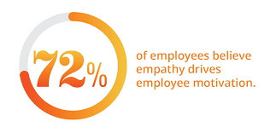
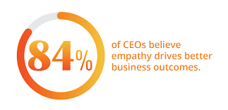
RTO: A Few Words on Prioritizing an Emotionally Healthy Workforce
The pandemic has worsened the already existing mental health crisis in the U.S. and made addressing it an urgent and essential priority
It’s in every employer’s interest to ensure an emotionally healthy workforce
A few of the grim statistics:
One in three Americans has lost someone to the virus
Tens of thousands of Americans have “long COVID”; medical community does not know if or when patients will recover
Oct. 2020 Kaiser Family Foundation survey: more than ½ of U.S. adults said their mental health had been “negatively impacted due to worry and stress over the coronavirus." KFF concluded:
"mental illnesses may soon be the most common pre-existing conditions“
Researchers: the pandemic aggravated burnout among workers, with millennials having the highest levels of burnout
What employers can do
EAPs necessary but not enough
Adopt/expand policies to ease stress, e.g., more PTO, flexible scheduling, job-sharing, mental health days, hybrid remote work, encourage use of vacation time
Adopt blackout periods – shut down cell phones and computers
Train supervisors to recognize signs of mental/emotional issues and on firm’s legal obligations to accommodate
Empathy is essential!

Slide 17
Responding to Requests for Accommodation
Due to a health condition
Normal EEOC considerations
NYC and CA documentation requirements
“Stacking” issues
If no legal obligation, should employers accommodate?
Due to children at home? (FFCRA protected leave?)
Due to transportation concerns?
Due to fear of contracting virus, even if not vulnerable?
OSHA: may refuse to work because of a reasonable belief that doing so would place the employee in danger of death or serious injury
Be consistent
Some states’ reopening guidelines advise seeking accommodation even where no legal obligation (e.g., vulnerable household member)
Consider unemployment insurance eligibility implications
ARPA: Employees who refuse to work for safety reasons may be eligible for unemployment compensation
AGAIN, DON’T FORGET ABOUT MENTAL HEALTH ISSUES – e.g., disability caused or exacerbated by pandemic (EEOC Guidance)…

Slide 18
Expense Reimbursement
Different rules for different states
Federal government and some states have no expense reimbursement rules, except that required expenses cannot drop employee’s wages below the minimum wage, even where expenses are incurred to perform at-home work
New York:
Employers who fail, neglect, or refuse to pay “benefits or wage supplements” to their employees are guilty of a misdemeanor
Examples of “benefits or wage supplements” listed in the statute include:
Reimbursement for business-related expenses
Health benefits
Welfare benefits
Retirement benefits
Vacation, separation, or holiday pay
Employers must reimburse their employees within 30 days of the reimbursement becoming due
The date reimbursement is due is typically the date that the employee submitted the expense for reimbursement
Law does not apply to bona fide professional, administrative, or executive employees who earn over $900 US per week

Slide 19
Expense Reimbursement: Best Practices
Understand the law in the applicable jurisdiction(s)
Develop expense reimbursement policies compliant with that law
Or “lowest common denominator” policy – compliant in all applicable jurisdictions
Policy considerations:
Written and clearly communicated to employees
Specific as to what expenses are reimbursable, based on what is “necessary” to perform job remotely
Consider providing a flat sum or percentage for certain recurring expenses, e.g., 50% of monthly cell phone bill, up to a set maximum
Provide a maximum reimbursement amount for required one-time purchases, e.g., printer, additional screens, webcam, etc.
Assess pros and cons of providing a monthly stipend and, if necessary, supplementing stipend for one-time purchase of more costly equipment, e.g., scanner
Ensure stipend is reasonable

Slide 20
RTO Issues: Get Your Ducks in a Row on OSHA Compliance
2020: OSHA was slow out of the gate on guidance and enforcement
2021: OSHA begins to get its groove back but still a little wobbly
January: Biden Executive Order on Protecting Worker Health and Safety
Advised OSHA to revise its COVID-19 recommendations and consider issuing Emergency Temporary Standard (ETS)
In response, no ETS (yet), but OSHA launched national emphasis program, focusing enforcement efforts on companies that put the largest number of workers at serious risk of contracting the coronavirus
Program also prioritizes employers that retaliate against workers for complaints about unsafe or unhealthy conditions, or for exercising other rights protected by federal law
OSHA released Protecting Workers: Guidance on Mitigating and Preventing the Spread of COVID-19 in Workplace:
Employers are required to provide workers with workplace free from recognized hazards that are causing or likely to cause death or serious physical harm
Urges employers to develop a COVID-19 prevention program to mitigate the spread of virus at work

Slide 21
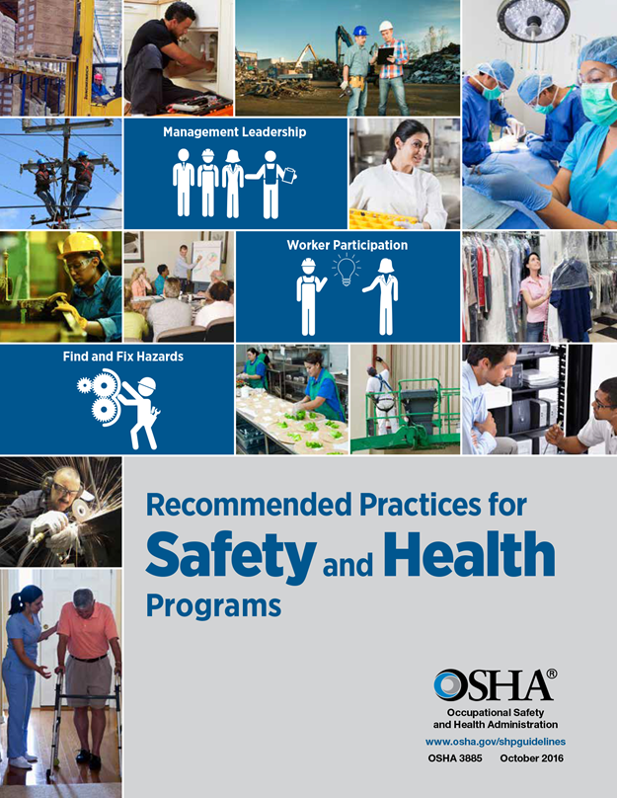
OSHA’s Guidance on Mitigating and Preventing the Spread of COVID-19 in Workplace (cont’d)
Obligates employers to record work-related COVID-19 illness
Instructs employers to continue to follow CDC Guidelines
Latest: Follow CDC recommendations for fully vaccinated individuals while the agency works on developing its own guidance
Urges employers to:
train human resources professionals and supervisors to approach COVID-19-related requests with care
avoid retaliation against workers for staying home due to illness
Still no ETS

Slide 22
New York Health and Essential Rights (HERO) Act
Part I: By June 4, 2021, NYS DOL to develop an industry-specific model airborne infectious disease exposure prevention standard (“model standard”) containing “minimum requirements for preventing exposure to airborne infectious diseases in the workplace”
Employers must adopt model standard or implement own plan
If employer creates own plan, must allow employees to participate in its development
Model standard (or employer plan) must provide procedures for:
conducting health screenings
ensuring workers have appropriate face coverings and PPE
creating hand hygiene protocols
regularly cleaning and disinfecting shared equipment and high-risk areas
maintaining social distancing protocols and capacity limits, as appropriate
complying with mandatory or precautionary orders of isolation or quarantine issued to employees
ensuring proper air flow, exhaust ventilation, etc.
assigning one or more supervisors the responsibility to ensure compliance with the employer’s plan and any applicable law
Complying with any obligation to notify workers of potential exposure
providing a verbal review of the infectious disease standard, employer policies, and employee rights under the Act

Slide 23
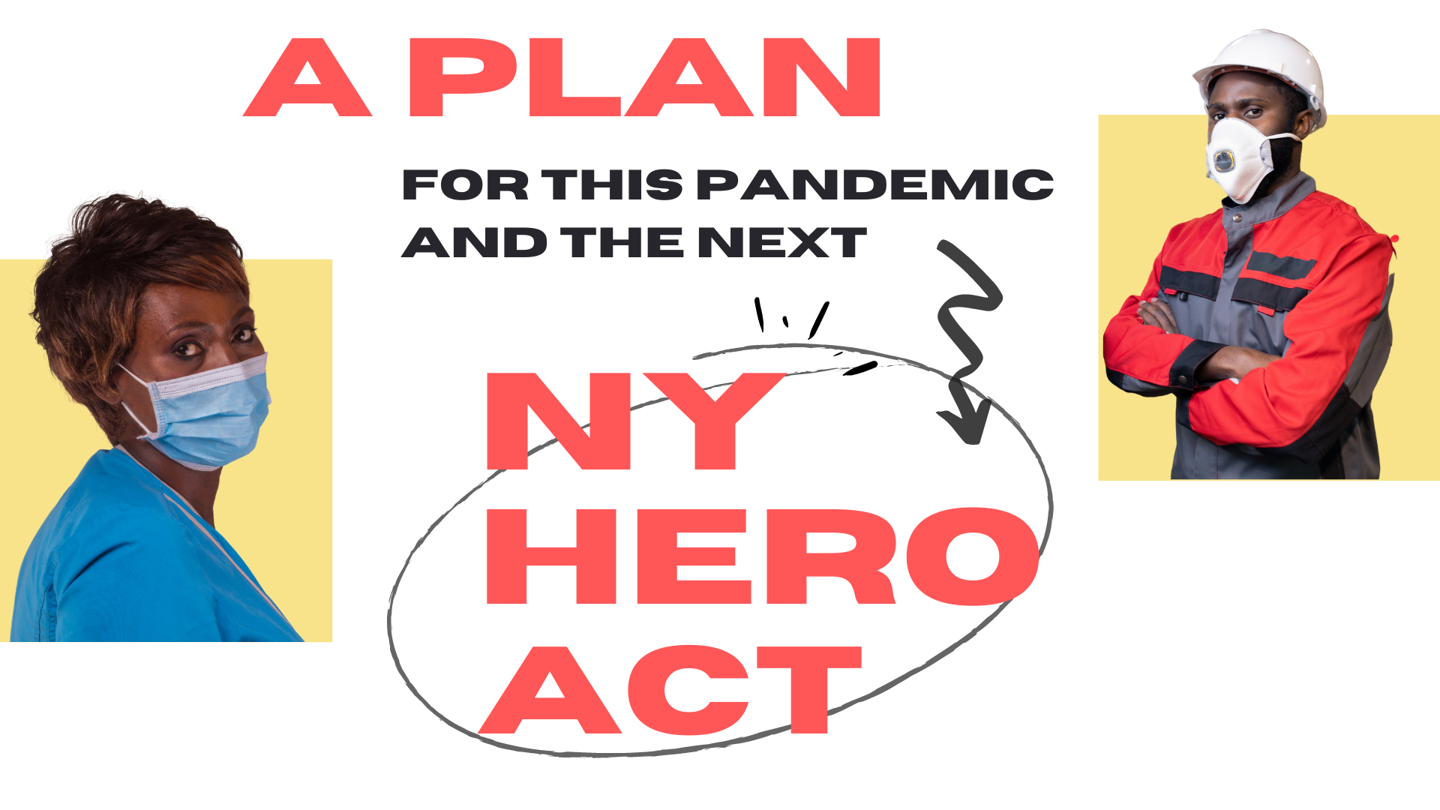
HERO Act (cont’d)
Part 2: Creation of Joint Labor-Management Workplace Safety Committee
By November 1, 2021: All private employers with at least 10 employees must permit their employees to establish and administer a joint labor-management workplace safety committee
Committee will have a range of responsibilities and authority, from raising health and safety concerns and reviewing policies adopted by the employer in response to the Act, to participating in site visits by a government agency
Scope of committee’s power not yet clear, e.g., appears not to be limited to matters related to HERO Act
The Act is awaiting NYS DOL guidance and “technical” revisions from legislature, pursuant to governor’s memo at signing

Slide 24
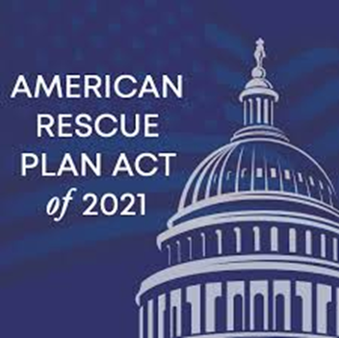
Update on COVID-19-Related Paid Leave Laws

Slide 25
2020: Family First Coronavirus Response Act (“FFCRA”) and “CARES”(Coronavirus Aid, Relief, and Economic Security) Act
FFCRA was enacted in March 2020 and expired on Dec. 31, 2020
In Dec. 2020, Congress extended FFCRA until March 31, 2021, but only as a voluntary program and employees could only use paid sick and FMLA leave they were entitled to in 2020 but did not use
FFCRA applied to public and private employers with fewer than 500 employees
Two key paid leave elements:
Emergency Paid Sick Leave Act -- up to 2 weeks at full pay up to cap, for specified reasons related to COVID-19
Some exemptions
Emergency Public Health Leave under the Family and Medical Leave Act
Up to 12 weeks at 2/3 pay, up to a cap
Some exemptions
CARES Act:
A rehired employee qualified for paid family benefits if the worker:
Was laid off by that employer on or after March 1, 2020, and
Had worked for the employer for at least 30 of the last 60 calendar days prior to his or her layoff

Slide 26
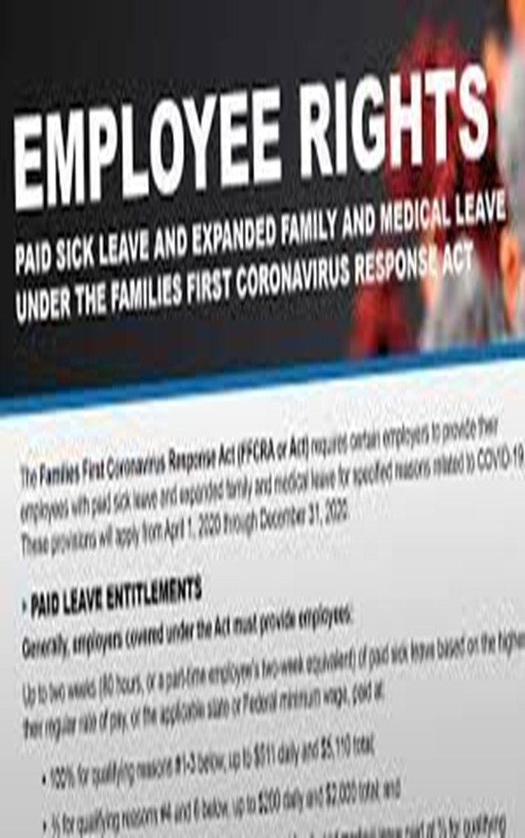
Review of FFCRA
Sick leave - 80 Hours
Employees may use if they are unable to work or telework because they are:
Subject to a government quarantine or isolation order related to COVID-19
Have been advised by health provider to self-quarantine due to COVID-19
Experiencing symptoms of COVID-19 and seeking medical diagnosis
Caring for an individual subject to quarantine order or self-quarantine
Caring for a son or daughter if school or place of care is closed or their child care provider is unavailable because of a public health emergency, or
Experiencing substantially similar conditions as specified by the Secretary of Health and Human Services
Paid at full pay (cap of $511/day) for reasons 1-3; 2/3 of pay (cap of $200/day) for reasons 4-6
Expanded FMLA Leave
Up to 12 weeks of FMLA leave for when employees must care for child whose school or day care is closed or whose child care provider is unavailable because of a public health emergency, and the employee cannot workor telework
Available to employees employed at least 30 days
First 10 days unpaid; rest paid at 2/3 of pay up to cap of $200/day and $10,000 in the aggregate
Both Leaves
Funded through employer tax credit matching value of sick/FMLA days paid
Small (<50) employers may be exempted from certain requirements

Slide 27
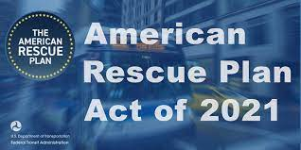
FFCRA as Amended by the American Rescue Plan Act
ARPA was enacted in March 2021
Extends and expands the FFCRA in certain respects
Permits employers with fewer than 500 employees to voluntarily continue to offer paid sick leave and paid expanded FMLA leave for eligible employees from April 1, 2021 through September 30, 2021
Expands reasons for using leave:
To get vaccinated
To recover from injury or illness resulting from the vaccine
While seeking or waiting for the results of a COVID-19 test
Provides an additional 10 days of paid sick leave:
Thus, total paid leave increased from 12 to 14 weeks
Continues and increases employer tax credit cap from $10,000 to $12,000
Employers must not favor highly compensated or full-time employees or discriminate on the basis of tenure with respect to the grant or denial of paid sick or paid FMLA leave
Violation of this provision jeopardizes entitlement to the tax credits

Slide 28
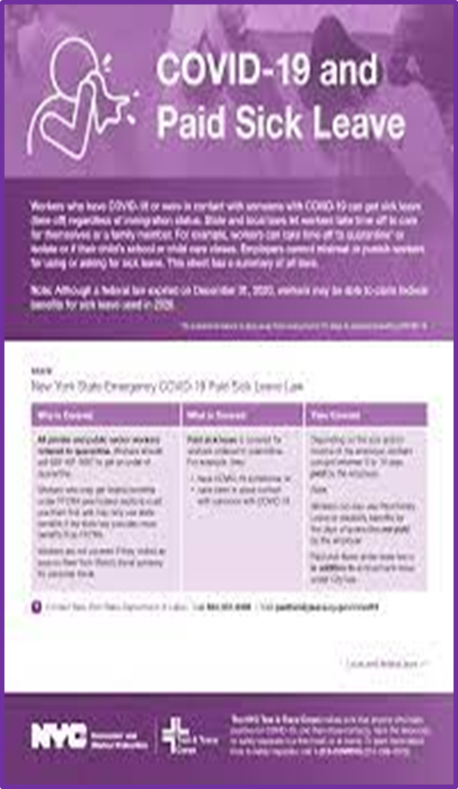
2020 Review: New York COVID-19-Related Leave Law
Emergency COVID-19 Leave
May be used by an employee who is subject to a mandatory or precautionary quarantine order (QO) related to COVID-19, or whose minor dependent child is under such QO
Requirements vary by size of business:
Small (10 or fewer employees and <$1 million net income): job protection for duration of quarantine/isolation
Medium (11-99 employees) (or small with > $1M net income): job protection & 5 days of paid sick leave
Large (100 or more employees): job protection & 14 days of paid sick leave
Leave is NOT available if the employee is:
Asymptomatic or has not yet been diagnosed with any medical condition, and
Physically able to work remotely while under quarantine
This leave entitlement is in addition to any sick leave or other paid time off the employer otherwise provides
Runs concurrently with FFCRA sick time, if applicable
If QO lasts longer than 14 days, employee may be eligible for benefits under NY’s STD and PFL programs

Slide 29
Jan. 2021: NYS DOL Guidance on COVID-19 Leave Law
NYS DOL’s new guidance on NYS COVID-19 Sick Leave Law appears to actually expand the law by increasing the availability of paid leave:
An employee who returns to work following a QO and subsequently tests positive must not report to work, is deemed subject to another QO, and is thus entitled to additional COVID-19 sick leave, even if employee already received such leave under the initial QO
An employee who continues to test positive for COVID-19 after the end of a QO period must not report to work and is deemed subject to another QO and entitled to additional COVID-19 sick leave
Employer that requires employee who is not subject to a QO to stay out of workplace “due to exposure or potential exposure” to COVID-19, regardless of where “such exposure or potential exposure ”may have occurred, MUST continue paying employee at his or her regular rate of pay
Even though the law requires QO for employee to get sick leave benefits
Guidance silent as to how long employer must pay employee, e.g., what if employee keeps testing positive for several months?
Guidance: Employees may qualify for COVID-19 sick leave under the law for up to three QOs!!

Slide 30
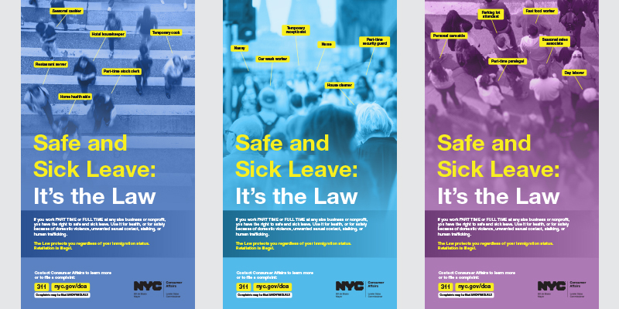
Don’t Forget About Non-COVID-Specific Leave Laws
Consider:
Do you have paid leave obligations under a non-COVID-specific paid or unpaid leave law that may be used for COVID-related leave?
E.g.:
federal FMLA (unpaid), which may be used to care for own or family member’s medical condition
Unpaid leave as a reasonable accommodation under federal ADA and state/local law
New York City’s Earned Safe and Sick Time Act, which permits the use of earned sick leave for certain public health emergencies

Slide 31
NY Paid Vaccination Leave Law
March 12, 2021: NY requires all employers to provide employees paid time off to get their vaccination shots
Employers must grant “a sufficient period of time, not to exceed four hours per vaccine injection” for a total of 8 hours (unless the employer or a collective bargaining agreement (“CBA”) provides for more than 4 hours)
Employees must receive “regular rate of pay”
Leave may not be charged against any existing bank of time off, including other paid sick leave, COVID-19 sick time, or any other PTO already granted under a CBA
However, entitlement can be waived in the future under the terms of a valid CBA, so long as the waiver includes an explicit reference to the law
Broad anti-retaliation provision
Sunsets on December 31, 2022
FAQs: Employers may require employees to provide notice, if feasible, and verification

Slide 32
The COVID-19 Legal Issue du Jour: Vaccination!

Slide 33
Latest CDC Guidance: “When You’ve Been Fully Vaccinated”
If you’ve been fully vaccinated:
Can “resume activities that you did prior to the pandemic”
Can “resume activities without wearing a mask or staying 6 feet apart, except where required by federal, state, local, tribal, or territorial laws, rules, and regulations, including local business and workplace guidance”
If you travel in the United States, you do not need to get tested before or after travel or self-quarantine after travel
Need to follow requirements of international destination
Do NOT need to get tested before leaving US unless destination requires it
Still must show a negative test result or documentation of recovery from COVID-19 before boarding an international flight to US
Still must get tested 3-5 days after international travel
Do NOT need to self-quarantine after arriving in US
If exposed to someone with COVID-19, you do not need to self-isolate or get tested unless you have symptoms

Slide 34
May 19, 2021: NYS Guidance for Fully Vaccinated Individuals
Mostly adopts CDC recommendations
Most NY employers may allow individuals who have been fully vaccinated to stop wearing a mask and social distancing in their workplace
Every business also has the discretion to continue rules regarding social distancing and masking, regardless of the employees’ or the patrons’ vaccination status
Alternatively, in most settings, an employer may require unvaccinated individuals to continue wearing a mask and practice socially distancing, at the same time permitting fully vaccinated individuals to forgo either or both of these protocols
Consistent with CDC recommendations, these new rules do not apply to public transit, pre-K-12 schools, healthcare settings, etc., all of which must continue to follow State’s existing COVID-19 health guidelines “until more New Yorkers are fully vaccinated”
Employers also have the option to seek proof of vaccination or rely on self-reporting (“the honor system”)
If proof required, can be in paper form, State’s Excelsior Pass, or via a digital application
Requesting proof not considered a medical inquiry, but if any copy of vaccination proof is obtained, it should be kept confidential and separate from employees’ personnel files
If an employer does not require proof of vaccination, it should keep in mind that the NY DOH “strongly recommends masks and six feet of social distancing in indoor settings where vaccination status of individuals is unknown”

Slide 35
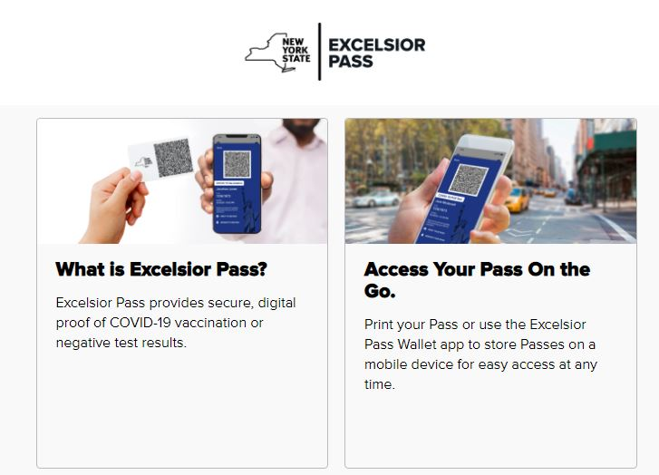
NY Has an App for That!
New York has a vaccine passport app – Excelsior Pass
Allows businesses to quickly scan the digital pass to determine a person’s vaccination status
Now used by large venues, e.g., sports arenas and stadiums
Can/will businesses uses them for employee vaccine verification?
Similar vaccine passports have been introduced in Nevada, Hawaii and California

Slide 36
Can An Employer Mandate Vaccination?
EEOC Guidance: FAQs
K.1. Under the ADA, Title VII, and other federal employment nondiscrimination laws, may an employer require all employees physically entering the workplace to be vaccinated for COVID-19?
K.5. Under the ADA, may an employer require a COVID-19 vaccination for all employees entering the workplace, even though it knows that some employees may not get a vaccine because of a disability?
Yes, subject to reasonable accommodation provisions and provided certain requirements are met.
An employer may require an individual with a disability to meet a qualification standard applied to all employees if the standard is job-related and consistent with business necessity.
If an employee cannot meet such a safety-related qualification standard because of a disability, the employer may not require compliance for that employee unless the individual would pose a “direct threat” to the health or safety of the employee or others in the workplace.

Slide 37
Pros and Cons of Mandating Vaccination
EEOC: Employers that mandate vaccination must seek accommodation if employee refuses to get vaccinated due to disability or a sincerely-held religious belief or practice
Assume religious belief sincerely held
Need to make individual assessment for disability
Standard: Is reasonable accommodation possible without causing “undue hardship?”
Title VII: more than minimal cost or burden
ADA: a significant difficulty or expense.
Engage in interactive process (In NYC, follow rules on “cooperative dialogue”)
If employee is not in need of accommodation, or if reasonable accommodation is unavailable, employer can discipline or terminate employee who refuses to get vaccinated, but best practice may be to seek an accommodation, such as remote work
CAVEAT: All 3 vaccines have only Emergency Use Authorization – they do not have full authorization or licensure from the FDA
BUT NY GUIDANCE: EMPLOYERS CAN MANDATE VACCINATION!!
Could still be challenged using EUA argument (State does not authority to mandate an EUA vaccine )
Some employers beginning to mandate vaccination for employees, e.g., producers of “Hamilton”

Slide 38
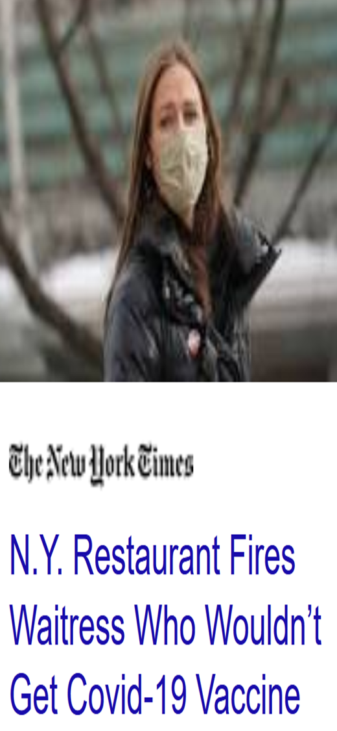
Pros and Cons of Mandating Vaccination (cont’d)
If vaccination not mandated and unvaccinated employees allowed in workplace:
Violation of OSHA General Duty clause?
Potential liability to others who contract virus from unvaccinated worker?
How will you know if employee is vaccinated?
Certain “proof” may implicate employee privacy rights under ADA and other laws – but EEOC and NY Guidance on avoiding this pitfall
Some states ban vaccine “passports,” e.g., FL, TX, BUT ALLOWED IN NY
Could strict mandatory vaccination policy create a PR headache (and possible legal exposure) ?
Allow reasonable accommodations for other reasons besides disability and religious beliefs? (NY Times story)
For example, WFH, regular testing, and masking and social distancing at the workplace
NEED FOR CONSISTENT ENFORCEMENT OF ALL ASPECTS OF POLICY

Slide 39
Pros and Cons of Voluntary Vaccination Policy
The key “pro”: Avoid potential legal risks implicated in a mandatory vaccination policy
BUT:
Is there potential OSHA violation and liability to others?
What if vaccinated employees refuse to work near unvaccinated co-workers?
Will clients, customers, vendors, etc. stay away?

Slide 40
Is Voluntary Policy Plus Encouragement, e.g., Incentives, a Good Compromise?
Can Employers Incentivize Employees to Get Vaccinated?
Yes, if incentive is not so substantial as to be coercive.
Is value of incentive really an issue at this point?
NY mandates paid vaccination leave – incentive?
Biden urging covered employers to encourage workers to take ARPA paid leave for vaccination
In support of this campaign, Treasury Department guidance on ARPA paid leave suggests: “For example, if an eligible employer offers employees a paid day off in order to get vaccinated, the employer can receive a tax credit…”
Following lead of other states, NY is offering more blatant incentives, e.g., lottery!

Slide 41
Is It Unlawful to Ask Employees if They’ve Been Vaccinated?
EEOC FAQs
K.9. Under the ADA, is it a “disability-related inquiry” for an employer to inquire about or request documentation or other confirmation that an employee obtained the COVID-19 vaccine from a third party in the community, such as a pharmacy, personal health care provider, or public clinic?
No. No. When an employer asks employees whether they obtained a COVID-19 vaccine from a third party in the community, the employer is not asking a question that is likely to disclose the existence of a disability; there are many reasons an employee may not show documentation or other confirmation of vaccination in the community besides having a disability. ..
However, documentation or other confirmation of vaccination provided by the employee to the employer is medical information about the employee and must be kept confidential.
NY Guidance: Employers can ask for proof of vaccination

Slide 42
Thoughts on Adopting a RTO Vaccination Policy in NY
NYS Guidance provides a useful roadmap for creating a policy that avoids many legal and practical pitfalls
Keep masking, social distancing, and at least some capacity limits IN PLACE for the time being, with one exception:
Employees who prefer not to mask, etc. may submit proof of vaccination if they so choose
Inform employees that the policy will be revisited when (as NYS Guidance suggests) “more people are vaccinated”
Puts onus on State Guidance: the NY DOH “strongly recommends masks and six feet of social distancing in indoor settings where vaccination status of individuals is unknown”
Benefits of this approach:
Helps to avoid some potential legal and practical issues inherent in both a mandatory and voluntary vaccination policy, e.g.,
What to do about: accommodation requests, employees who refuse to vaccinate or work with unvaccinated/unmasked co-workers, stigmatizing unvaccinated employees, stigmatizing vaccinated workers who still want to mask up and socially distance, etc.
Can still seek to incentivize employees to get vaccinated

Slide 43
Questions

Slide 44
Please Note:
This presentation has been provided for informational purposes only and is not intended and should not be construed to constitute legal advice. Please consult your attorneys in connection with any fact-specific situation under federal, state, and/or local laws that may impose additional obligations on you and your company.
Attorney Advertising

